Slide 1
Data Encryption Standard

Slide 2
Modern Block Ciphers
look at modern block ciphers
one of the most widely used types of cryptographic algorithms
provide secrecy /authentication services
focus on DES (Data Encryption Standard)
to illustrate block cipher design principles
Notes:
Modern block ciphers are widely used to provide encryption of quantities of information, and/or a cryptographic checksum to ensure the contents have not been altered. We continue to use block ciphers because they are comparatively fast, and because we know a fair amount about how to design them. Will use the widely known DES algorithm to illustrate some key block cipher design principles.

Slide 3
Block vs Stream Ciphers
block ciphers process messages in blocks, each of which is then en/decrypted
like a substitution on very big characters
  64-bits or more
stream ciphers process messages a bit or byte at a time when en/decrypting
many current ciphers are block ciphers
broader range of applications
Notes:
Block ciphers work a on block / word at a time, which is some number of bits. All of these bits have to be available before the block can be processed. Stream ciphers work on a bit or byte of the message at a time, hence process it as a “stream”. Block ciphers are currently better analysed, and seem to have a broader range of applications, hence focus on them.

Slide 4
Shannon's Guide to Good Ciphers
Amount of secrecy should determine amount of labor appropriate for encryption and decryption
The set of keys and enciphering algorithm should be free from complexity
The implementation should be as simple as possible
Errors in ciphering should not propagate
Size of the enciphered text should be no larger than the original

Slide 5
Block Cipher Principles
most symmetric block ciphers are based on a Feistel Cipher Structure
Go through a number of rounds for encryption
block ciphers look like an extremely large substitution
Efficient decryption: Same as the encryption algorithm but uses round keys in reverse order
Notes:
Most symmetric block encryption algorithms in current use are based on a structure referred to as a Feistel block cipher. A block cipher operates on a plaintext block of n bits to produce a ciphertext block of n bits. An arbitrary reversible substitution cipher for a large block size is not practical, however, from an implementation and performance point of view. In general, for an n-bit general substitution block cipher, the size of the key is n x 2^{n}. For a 64-bit block, which is a desirable length to thwart statistical attacks, the key size is 64 x 2⁶⁴ = 2⁷⁰ = 10²¹ bits. In considering these difficulties, Feistel points out that what is needed is an approximation to the ideal block cipher system for large n, built up out of components that are easily realizable.

Slide 6

Ideal Block Cipher
Notes:
Feistel refers to an n-bit general substitution as an ideal block cipher, because it allows for the maximum number of possible encryption mappings from the plaintext to ciphertext block. A 4-bit input produces one of 16 possible input states, which is mapped by the substitution cipher into a unique one of 16 possible output states, each of which is represented by 4 ciphertext bits. The encryption and decryption mappings can be defined by a tabulation, as shown in Stallings Figure 3.1. It illustrates a tiny 4-bit substitution to show that each possible input can be arbitrarily mapped to any output - which is why its complexity grows so rapidly.

Slide 7
Claude Shannon and Substitution-Permutation Ciphers
Claude Shannon introduced idea of substitution-permutation (S-P) networks in 1949
form basis of modern block ciphers
S-P nets are based on the two primitive cryptographic operations:
  substitution (S-box)
  permutation (P-box)
provide confusion & diffusion of message & key
Notes:
Claude Shannon’s 1949 paper has the key ideas that led to the development of modern block ciphers. Critically, it was the technique of layering groups of S-boxes separated by a larger P-box to form the S-P network, a complex form of a product cipher. He also introduced the ideas of confusion and diffusion, notionally provided by S-boxes and P-boxes (in conjunction with S-boxes).

Slide 8
Diffusion and Confusion…
Diffusion:
“The statistical structure of the plaintext is spread (dissipated) into long-range statistics of the ciphertext.”
Objective is to globalize the local affects.

Slide 9
Diffusion and Confusion…
Confusion:
“Attempts to make the relationship between the ciphertext and the encryption key as complex as possible.”
Achieved by using a complex substitution algorithm.
Even if an attacker can get some statistics of the ciphertext, it is very difficult to deduce the key.
In other words, Interceptor should not be able to predict how ciphertext will change by changing one character

Slide 10
Feistel Cipher Structure
Horst Feistel devised the feistel cipher
  based on concept of invertible product cipher
partitions input block into two halves
  process through multiple rounds which
  perform a substitution on left data half
  based on round function of right half & subkey
  then have permutation swapping halves
implements Shannon’s S-P net concept
Notes:
Horst Feistel, working at IBM Thomas J Watson Research Labs devised a suitable invertible cipher structure in early 70's.
One of Feistel's main contributions was the invention of a suitable structure which adapted Shannon's S-P network in an easily inverted structure. It partitions input block into two halves which are processed through multiple rounds which perform a substitution on left data half, based on round function of right half & subkey, and then have permutation swapping halves. Essentially the same h/w or s/w is used for both encryption and decryption, with just a slight change in how the keys are used. One layer of S-boxes and the following P-box are used to form the round function.

Slide 11
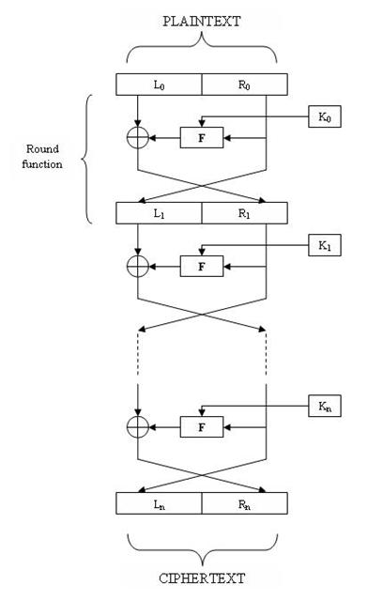



Feistel Network Structure
CIPHERTEXT
PLAINTEXT
Encrypt
Decrypt

Slide 12
Feistel Cipher Design Elements
block size
key size
number of rounds
subkey generation algorithm
round function
fast software en/decryption
ease of analysis
Notes:
The exact realization of a Feistel network depends on the choice of the following parameters and design features:
block size - increasing size improves security, but slows cipher
key size - increasing size improves security, makes exhaustive key searching harder, but may slow cipher
number of rounds - increasing number improves security, but slows cipher
subkey generation algorithm - greater complexity can make analysis harder, but slows cipher
round function - greater complexity can make analysis harder, but slows cipher
fast software en/decryption - more recent concern for practical use
ease of analysis - for easier validation & testing of strength

Slide 13
DES History
IBM developed Lucifer cipher
  by team led by Feistel in late 60’s
  used 64-bit data blocks with 128-bit key
then redeveloped as a commercial cipher with input from NSA and others
in 1973 NBS (now NIST) issued request for proposals for a national cipher standard
IBM submitted their revised Lucifer which was eventually accepted as the DES
Notes:
In the late 1960s, IBM set up a research project in computer cryptography led by Horst Feistel. The project concluded in 1971 with the development of the LUCIFER algorithm. LUCIFER is a Feistel block cipher that operates on blocks of 64 bits, using a key size of 128 bits.
Because of the promising results produced by the LUCIFER project, IBM embarked on an effort, headed by Walter Tuchman and Carl Meyer, to develop a marketable commercial encryption product that ideally could be implemented on a single chip. It involved not only IBM researchers but also outside consultants and technical advice from NSA. The outcome of this effort was a refined version of LUCIFER that was more resistant to cryptanalysis but that had a reduced key size of 56 bits, to fit on a single chip.
In 1973, the National Bureau of Standards (NBS) issued a request for proposals for a national cipher standard. IBM submitted the modified LUCIFER. It was by far the best algorithm proposed and was adopted in 1977 as the Data Encryption Standard.

Slide 14
DES Design Controversy
although DES standard is public
was considerable controversy over design
  in choice of 56-bit key (vs Lucifer 128-bit)
  and because design criteria were classified
subsequent events and public analysis show in fact design was appropriate
use of DES has flourished
  especially in financial applications
  still standardised for legacy application use
Notes:
Before its adoption as a standard, the proposed DES was subjected to intense & continuing criticism over the size of its key & the classified design criteria.
Recent analysis has shown despite this controversy, that DES is well designed. DES is theoretically broken using Differential or Linear Cryptanalysis but in practise is unlikely to be a problem yet. Also rapid advances in computing speed though have rendered the 56 bit key susceptible to exhaustive key search, as predicted by Diffie & Hellman.
DES has flourished and is widely used, especially in financial applications. It is still standardized for legacy systems, with either AES or triple DES for new applications.

Slide 15
Data Encryption Standard (DES)

Slide 16
DES STRUCTURE
The encryption process is made of two permutations (P-boxes), which we call initial and final permutations, and sixteen Feistel rounds.
Topics
Initial and Final Permutations
16 Feistel Rounds
Cipher and Reverse Cipher
Examples

Slide 17
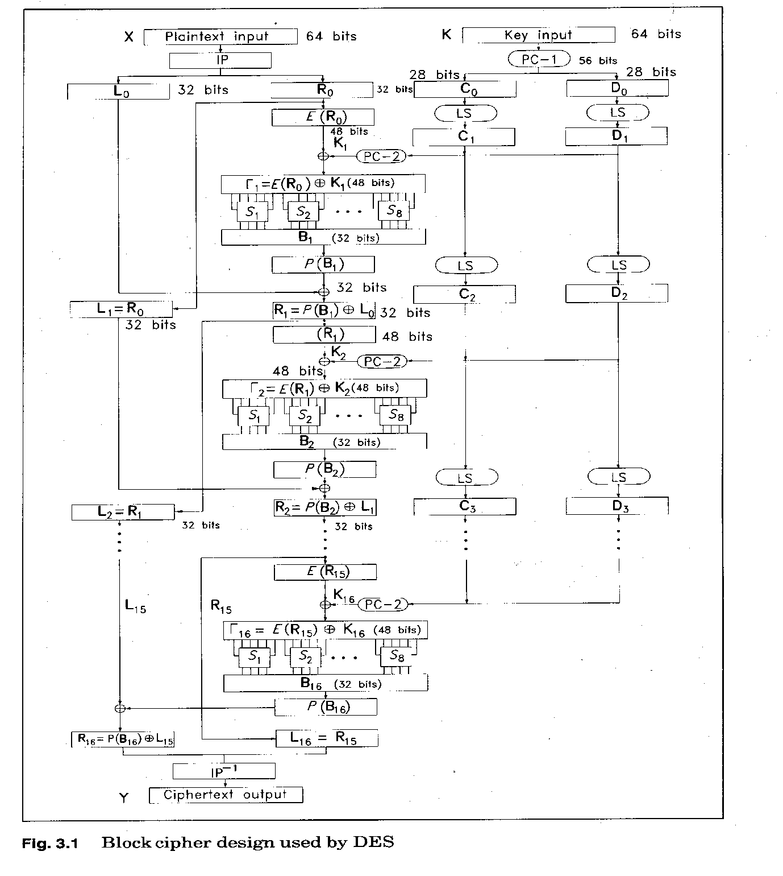
DES in a nutshell

Slide 18

General structure of DES

Slide 19

Initial and Final Permutations
Initial and final permutation steps in DES

Slide 20
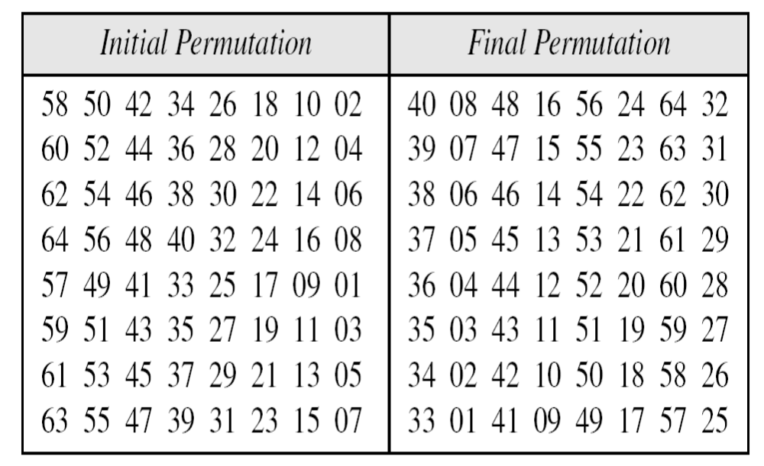
Initial and final permutation tables

Slide 21

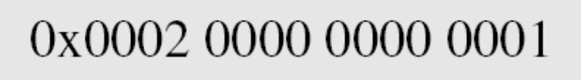
Example
Find the output of the final permutation box when the input is given in hexadecimal as:
Solution
Only bit 25 and bit 63 are 1s; the other bits are 0s. In the final permutation, bit 25 becomes bit 64 and bit 63 becomes bit 15. The result is

Slide 22
Example
Prove that the initial and final permutations are the inverse of each other by finding the output of the final permutation if the input is
Solution
The input has only two 1s; the output must also have only two 1s. Using Table 6.1, we can find the output related to these two bits.
15
63
15
64
25
64

Slide 23
The initial and final permutations are straight P-boxes that are inverses
of each other.
They have no cryptography significance in DES.

Slide 24
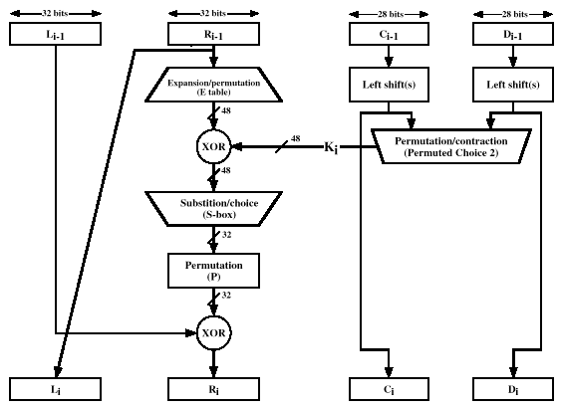
The 16 Rounds of F Consist Of:

Slide 25

Rounds
DES uses 16 rounds. Each round of DES is a Feistel cipher.
A round in DES
(encryption site)

Slide 26

DES Function
The heart of DES is the DES function. The DES function applies a 48-bit key to the rightmost 32 bits to produce a 32-bit output.
DES function

Slide 27

Expansion
Expansion P-box
Since R_{I−1} is a 32-bit input and K_{I} is a 48-bit key, we first need to expand R_{I−1} to 48 bits.
Expansion permutation

Slide 28
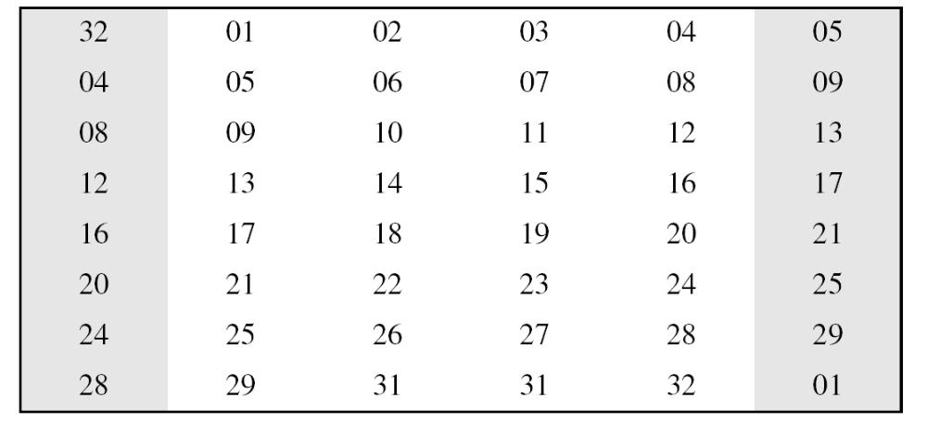
Expansion contd…
Although the relationship between the input and output can be defined mathematically, DES uses the following Table to define this P-box.
Expansion P-box table

Slide 29
Whitener (XOR)
After the expansion permutation, DES uses the XOR operation on the expanded right section and the round key. Note that both the right section and the key are 48-bits in length. Also note that the round key is used only in this operation.

Slide 30

S-Boxes
The S-boxes do the real mixing (confusion). DES uses 8 S-boxes, each with a 6-bit input and a 4-bit output.

Slide 31

S-box

Slide 32
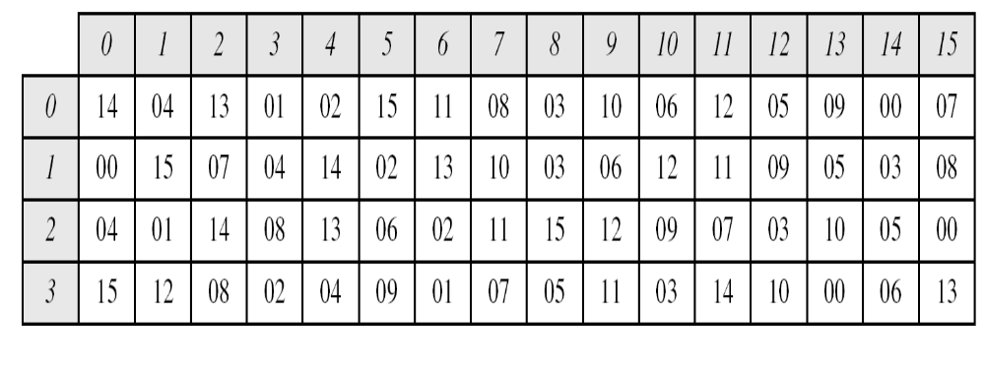
S-box
permutation for S-box 1

Slide 33
Example
The input to S-box 1 is 100011. What is the output?
Solution
If we write the first and the sixth bits together, we get 11 in binary, which is 3 in decimal. The remaining bits are 0001 in binary, which is 1 in decimal. We look for the value in row 3, column 1, in S-box 1. The result is 12 in decimal.

Slide 34
Example
The input to S-box 8 is 000000. What is the output?
Solution
If we write the first and the sixth bits together, we get 00 in binary, which is 0 in decimal. The remaining bits are 0000 in binary, which is 0 in decimal. We look for the value in row 0, column 0, S-box 1. The result is 14 in decimal.

Slide 35
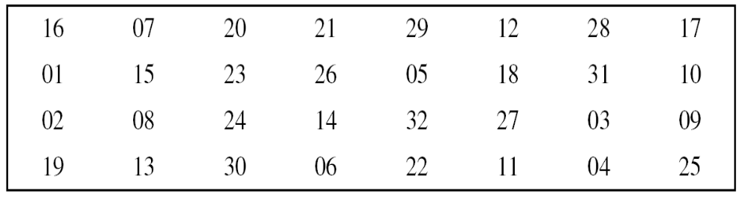
Straight Permutation
Straight permutation table

Slide 36

DES Cipher and Reverse Cipher

Slide 37

Key Generation

Slide 38
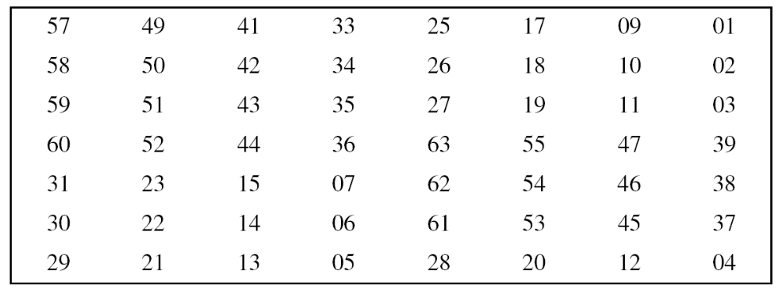
Key Generation
Parity-bit drop table
Number of bits shifts

Slide 39
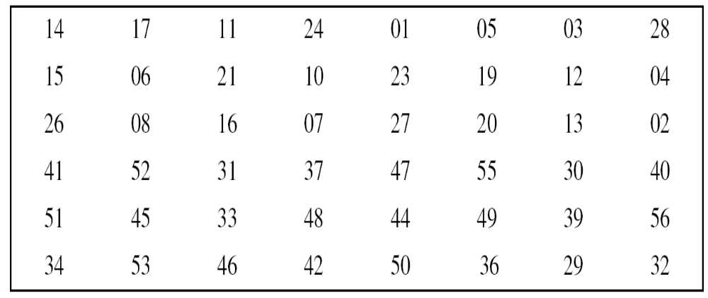
Key Compression Table

Slide 40
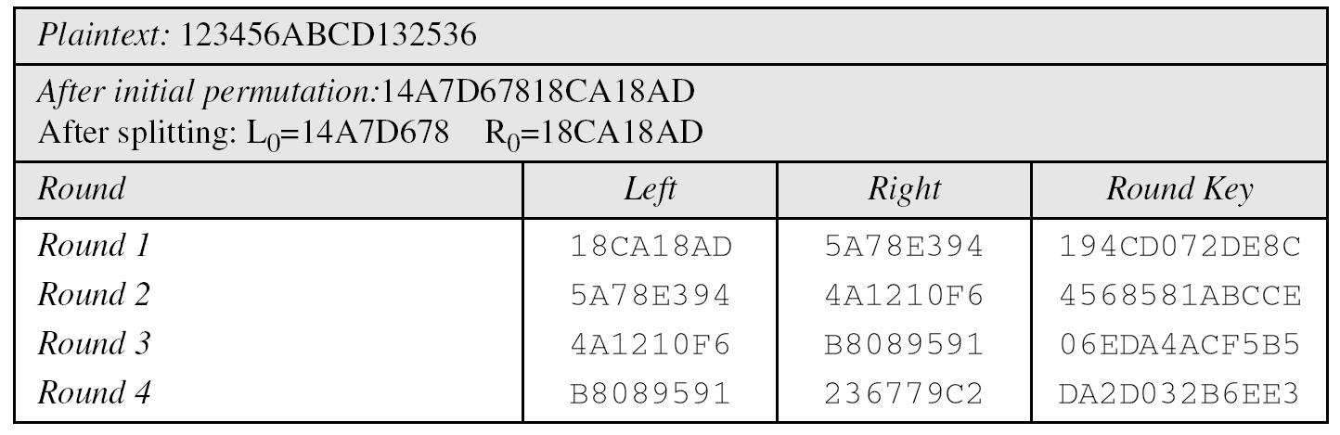
DES Examples
We choose a random plaintext block and a random key, and determine what the ciphertext block would be (all in hexadecimal):
Trace of data

Slide 41
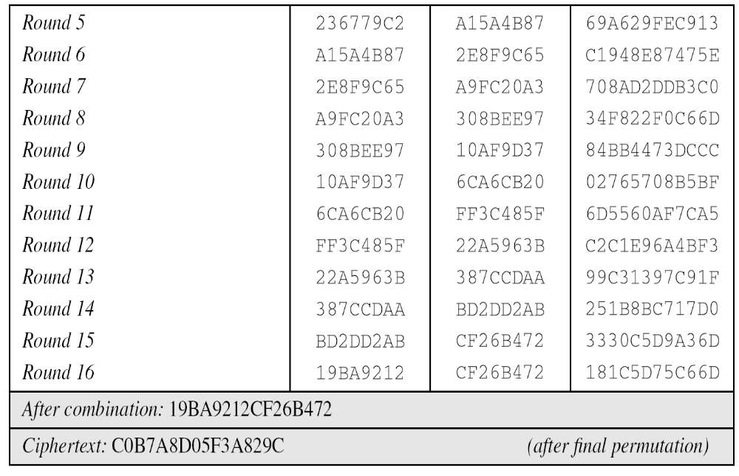

Slide 42
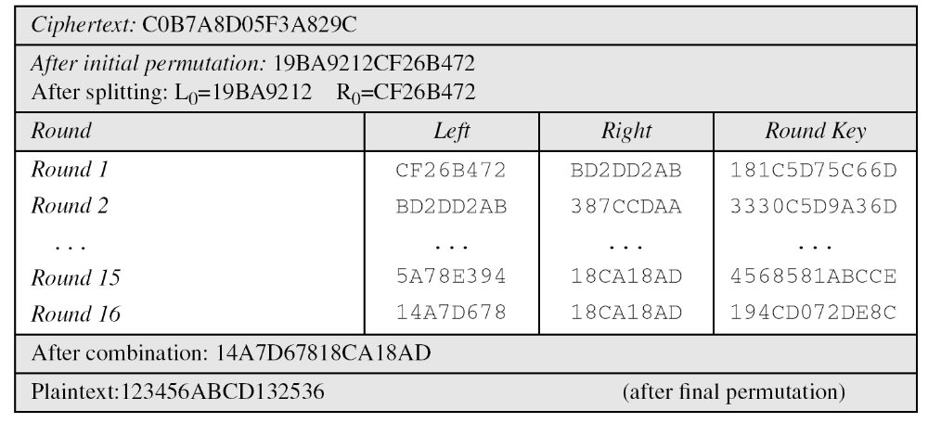
DES Examples
Let us see how Bob, at the destination, can decipher the ciphertext received from Alice using the same key.
some interesting points.

Slide 43
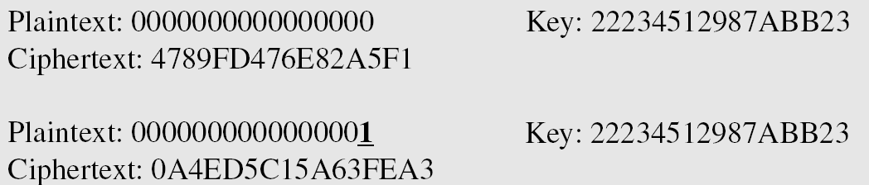
DES Analysis
Two desired properties of a block cipher are the avalanche effect and the completeness.
avalanche effect a change of one input or key bit results in changing approx half of the output bits
Completeness effect means that each bit of the ciphertext needs to depend on many bits on the plaintext.
Example
To check the avalanche effect in DES, let us encrypt two plaintext blocks (with the same key) that differ only in one bit and observe the differences in the number of bits in each round.

Slide 44
Although the two plaintext blocks differ only in the rightmost bit, the ciphertext blocks differ in 29 bits. This means that changing approximately 1.5 percent of the plaintext creates a
change of approximately 45 percent in the ciphertext.

Slide 45
Design Criteria
S-Boxes
The design provides confusion and diffusion of bits from each round to the next.
P-Boxes
They provide diffusion of bits.
Number of Rounds
DES uses sixteen rounds of Feistel ciphers. the ciphertext is thoroughly a random function of plaintext and ciphertext.

Slide 46
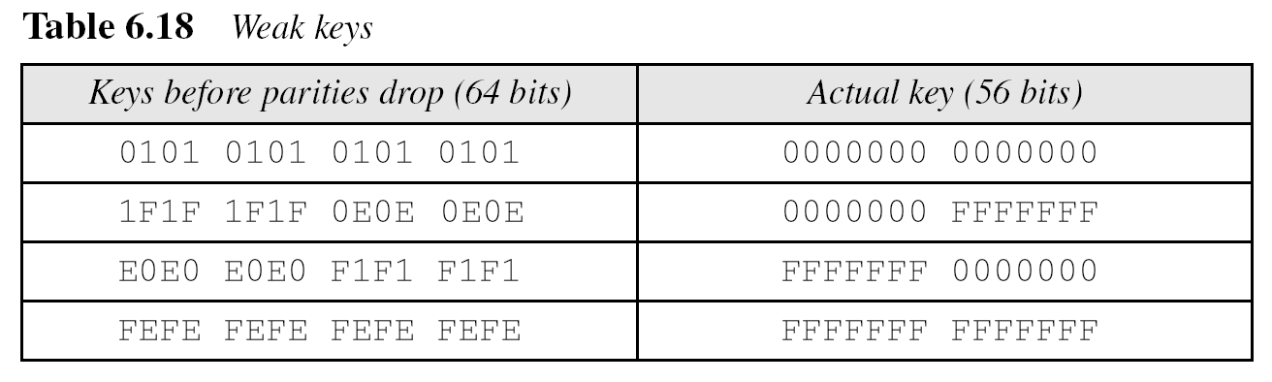
DES Weaknesses
During the last few years critics have found some weaknesses in DES.
Weaknesses in Cipher Design
1. Weaknesses in S-boxes
2. Weaknesses in P-boxes
3. Weaknesses in Key

Slide 47
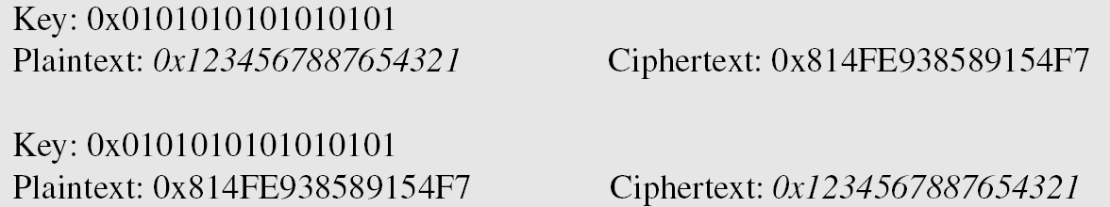
Example
Let us try the first weak key in previous Table to encrypt a block two times. After two encryptions with the same key the original plaintext block is created. Note that we have used the encryption algorithm two times, not one encryption followed by another decryption.

Slide 48
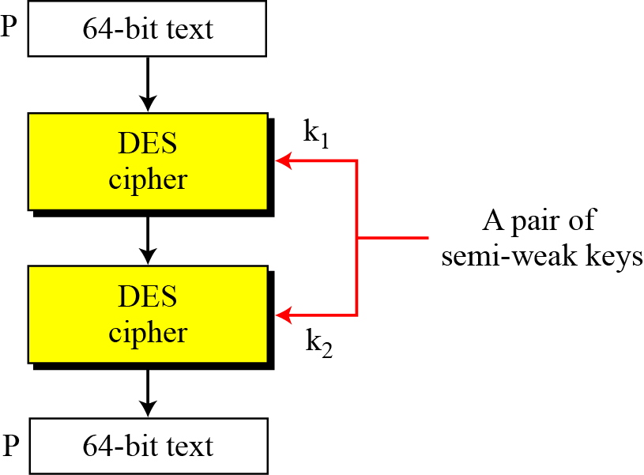
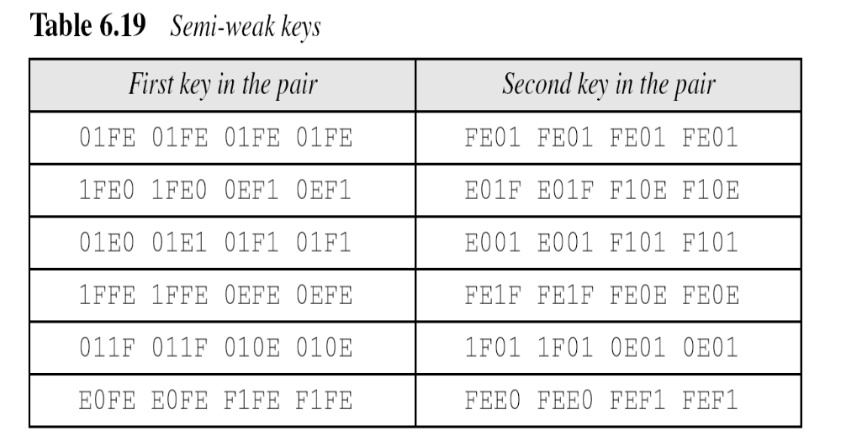
Semi-Weak Keys
6.<number>

Slide 49
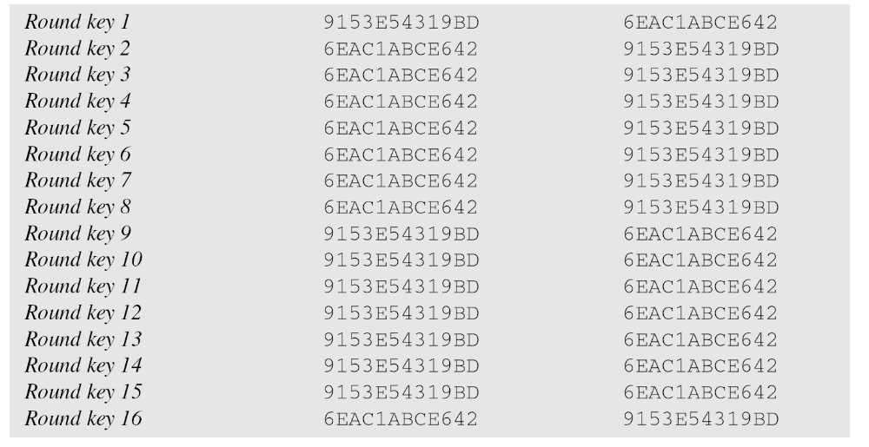
Semi Weak Keys
6.<number>

Slide 50
What is the probability of randomly selecting a weak, a semi-weak, or a possible weak key?
Solution
DES has a key domain of 2⁵⁶. The total number of the above keys are 64 (4 + 12 + 48). The probability of choosing one of these keys is 8.8 × 10⁻¹⁶, almost impossible.
6.<number>
Notes:
64/2pow56

Slide 51
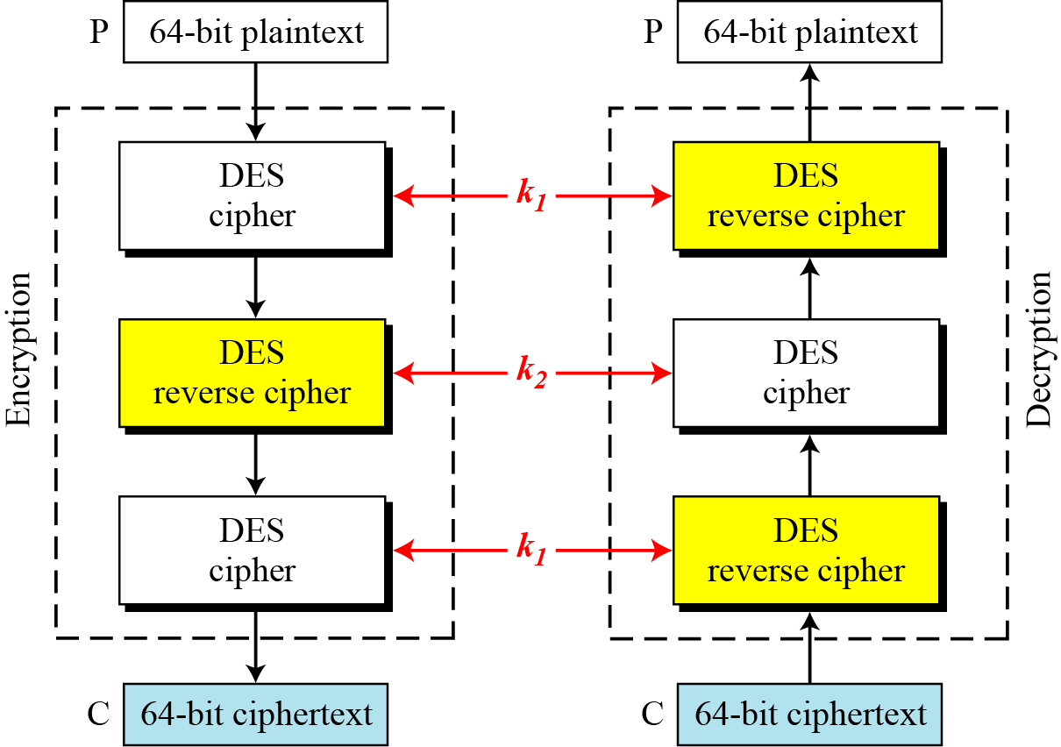
6.4.2 Triple DES
Figure 6.16 Triple DES with two keys
6.<number>

Slide 52
Cryptography and Network Security”, 4/e, by William Stallings, Chapter 3 – “Block Ciphers and the Data Encryption Standard”.
Cryptography and Network Security, Chapter 6, Behrouz Forozan

